Slide 1

Dashboard App for Students
Guide
Batch - 16
J. Vudaya Kumar
Suchen Oguri
(Y10IT1241)
Assoc. Prof
Dept. of CSE & IT

Slide 2
Contents
Abstract
Motivation & Objectives
Modules
Features
System Requirements
Technologies used
Advantages
Future Enhancements

Slide 3
Abstract
“Dashboard App for students” deals with all kind of student details, academic related notifications, college details, course details, curriculum and other resource related details too. tracking of attendance, progress in the course, completed semesters years, coming semester year curriculum details, exam details, or any other assignment details, exam result; and all these will be available for future references too.

Slide 4
Motivation & Objectives
Now a days so many web based applications are available for students
Students should go through websites for attendance, marks, fee schedules, exam schedules, exam results, and other notifications
Quick access
User friendly environment

Slide 5
Motivation & Objectives
Our project is to provide an application for smart phones and tablets running with a smart operating systems
Mainly concentrated on notifications to students and parents
Notifications related to fees, exams, results, news and other updates.

Slide 6
Modules
USER MODULE ONLY
Features - Student
Authentication - Register No & Password
Sign up – Needs to be approved by Admin

Slide 7
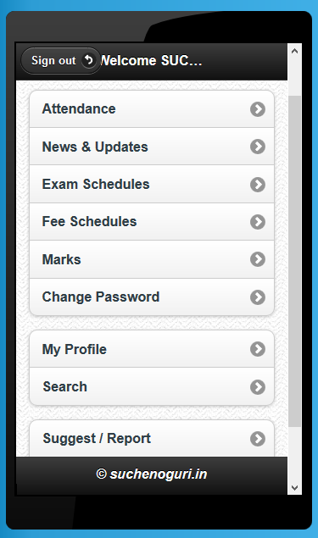
Features
Attendance information
News and updates
Exam schedules
Fee schedules
Internal marks
Profile
Search a student ..etc..,

Slide 8
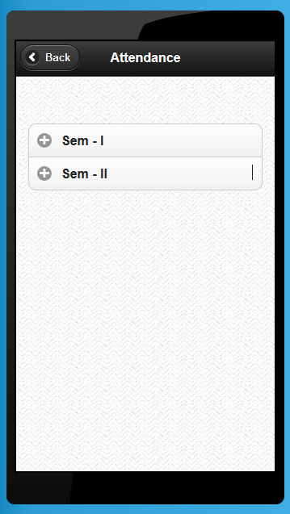
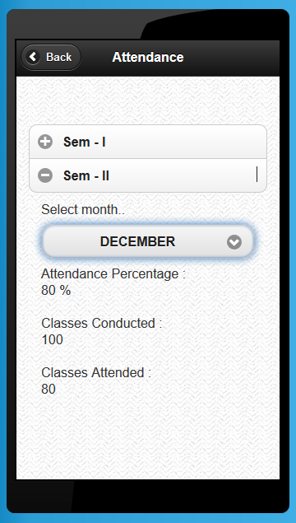
Attendance information

Slide 9
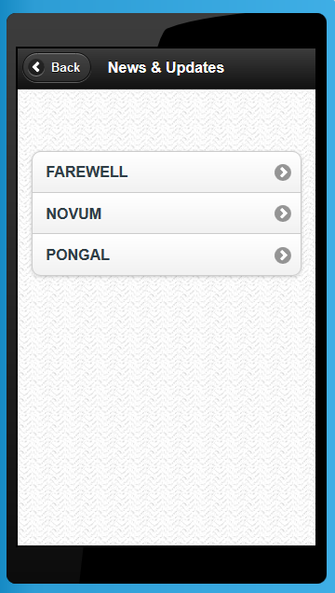
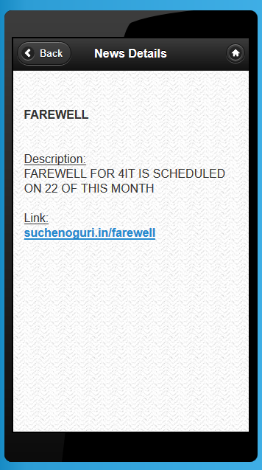
News and updates

Slide 10
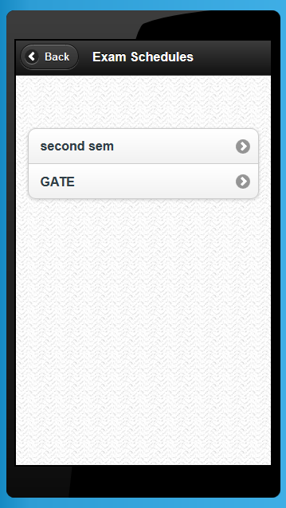
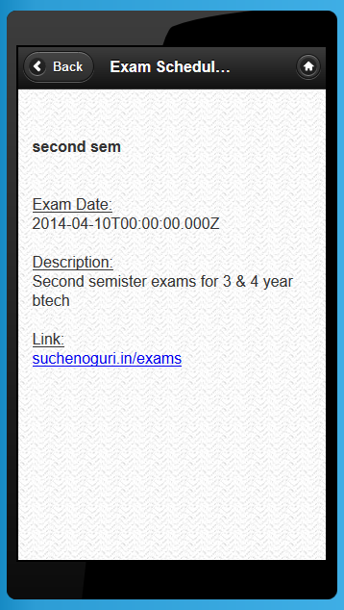
Exam schedules

Slide 11
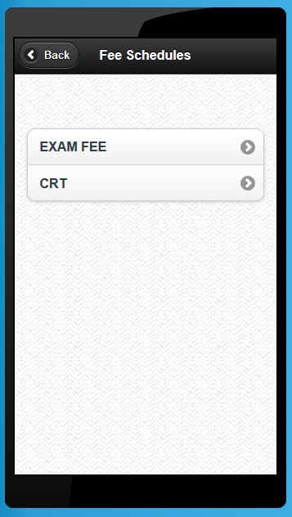
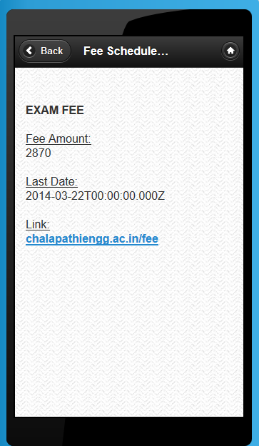
Fee schedules

Slide 12
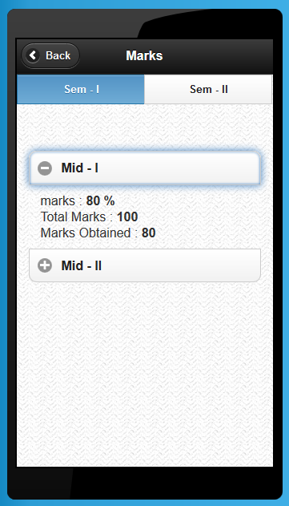
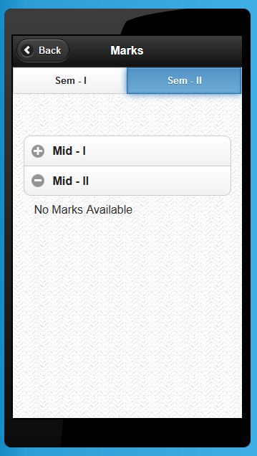
Internal marks

Slide 13
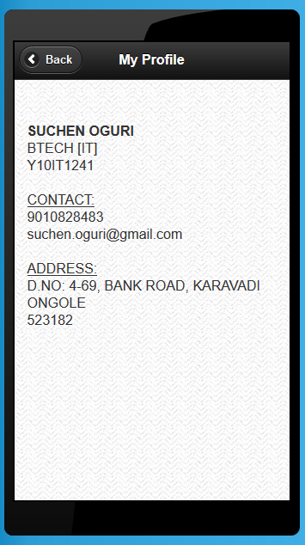
Profile

Slide 14
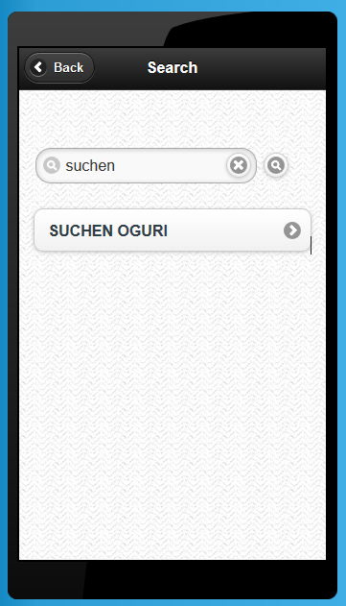
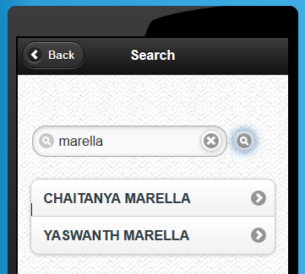
Search

Slide 15
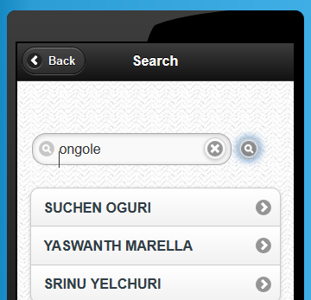
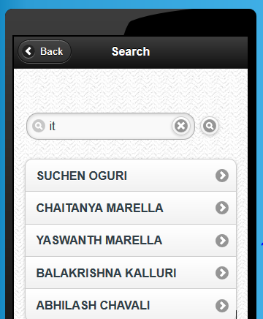
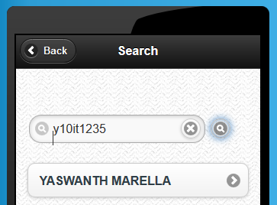
Search

Slide 16
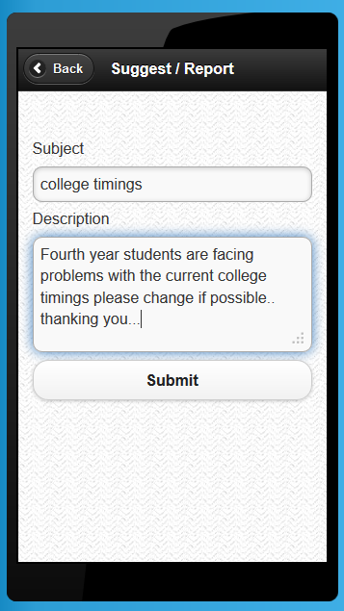
Suggestions / Reports

Slide 17
System Requirements
Can run in mobile web browser.
Smart phones/tabs with min 512mb of RAM
Supported operating systems
Android
ios
Windows mobile / windows 8 desktop app
Black Berry

Slide 18
Technologies used
Platform : IBM Worklight
Tool : Eclipse IDE
Database : DB2 Express-C
Server : Websphere

Slide 19
Advantages
Quick access to the databases
Convenient access with mobility
Easier controlling and look and feel user interface
Less data consumption
Facilitates quick search

Slide 20
Future Enhancements
Everything has its own scope of modification and improvements
In this project we will add more modules and features that support extra information
we will improve its security features using advanced technologies so that unauthorized user can’t break the integrity and authenticity

Slide 21
Conclusion
Provides easy, accurate, unambiguous and faster data access
So many other features and modules are also possible to extend this application
Helpful to perform paperless work and manage all data

Slide 22
Now, Q&A .. ..??

Slide 23
THANK YOU ☺

